Slide 1
Achievements: Functionality
What we completed in Sprint 2
Completed backlog items
User registration and login completed
Scooter list and map view completed
Booking creation workflow completed
Simulated payment workflow completed
Booking history page completed
Booking details page completed
Booking cancellation and extension completed
Feedback / issue reporting completed
Admin dashboard completed
User records and booking records pages completed
Scooter configuration and issue management pages completed
Revenue analytics page completed

Slide 2
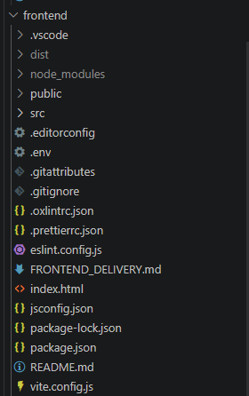
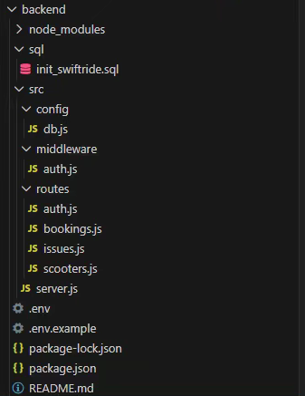
Achievements: System and Code
Current implementation progress
Technical progress
Frontend built with Vue, Vite, Pinia, and Vue Router
Customer and admin modules are both available
Booking, payment, feedback, and admin pages are connected
Frontend demo data flow supports complete presentation
UI layout and visual style were improved for the sprint review
Backend structure for auth, scooters, bookings, and payment already exists
Frontend build test passed successfully

Slide 3
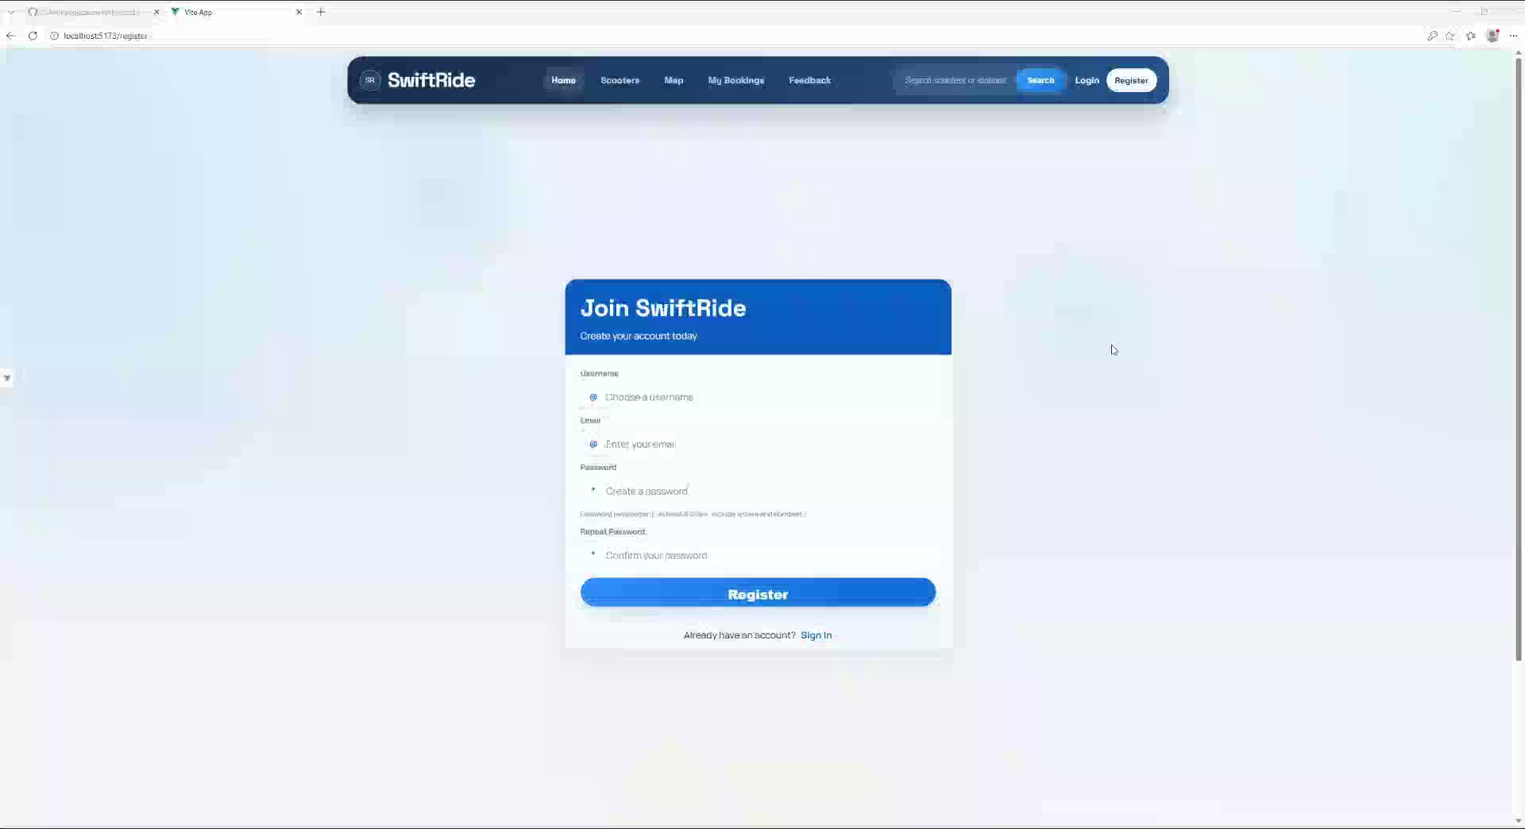
Achievements: Demo

Slide 4
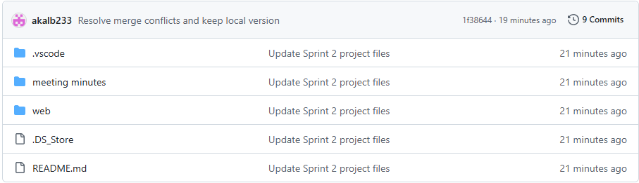
Process
How the team organized work and recorded Sprint 1 progress
Process and records
Continued using Git and GitHub for shared development
Split work across frontend, backend, and testing tasks
Held meetings regularly to review sprint progress
Recorded sprint materials and meeting notes
Updated backlog items based on implementation progress
Used screenshots and working pages as sprint evidence

Slide 5
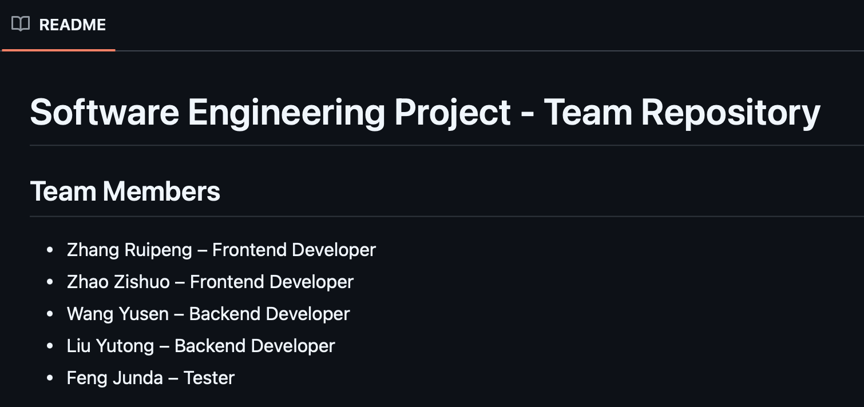
Team Management
How the team handled communication, decisions, and sprint priorities
Management focus in Sprint 2
Maintained communication through the team chat group
Coordinated frontend and backend tasks regularly
Focused on core business workflow first
Adjusted priorities to ensure a working demo
Managed time by finishing the most visible features first
Discussed technical issues such as booking state flow and admin features

Slide 6
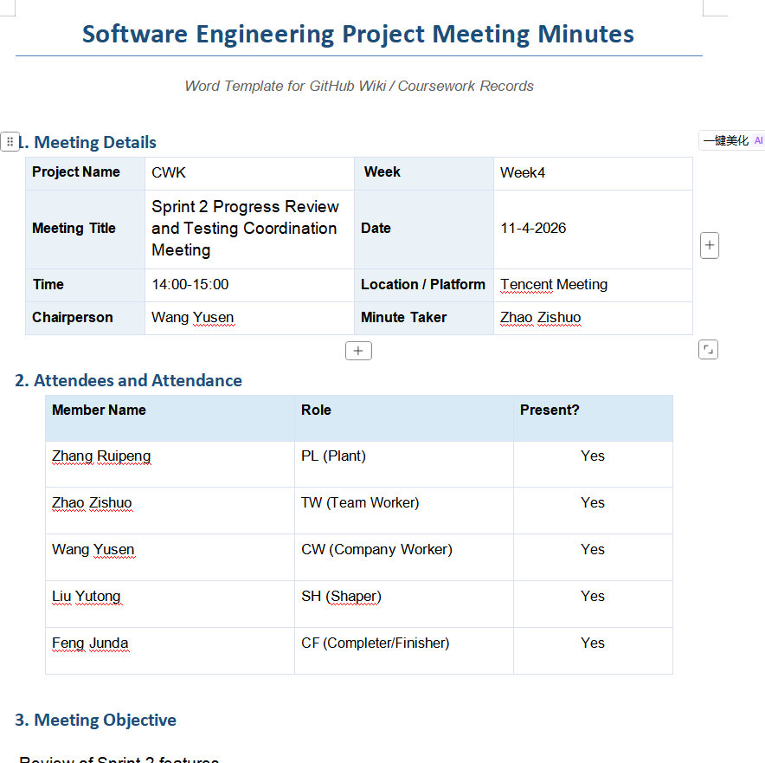
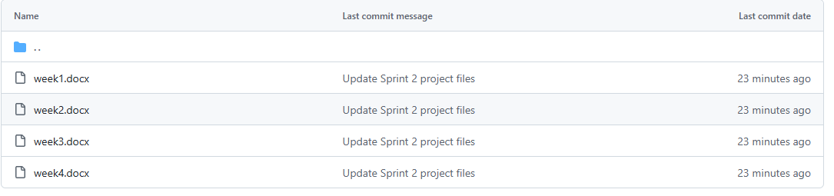
Team Management-Meeting Minutes

Slide 7
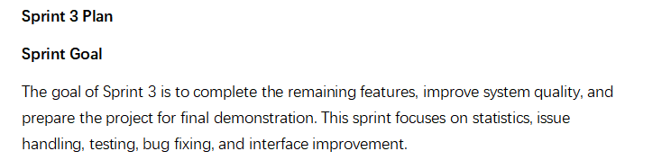
Next Sprint Plan
Focus areas for Sprint 3
•Income statistics feature
•Rental price configuration function
•Issue reporting and issue management functions
•Improved and more user-friendly interface
•Test cases and testing report
•Bug fixing records
•Final project documentation
•Demo-ready working system

